Slide 1
JavaScript and the future

Slide 2
Standards
ECMAScript is the standards that JavaScript is based on.
Today most JavaScript written is based on ECMAScript 5.1

Slide 3
The future
ECMAScript 6 is on the way
Standards set to be locked down by mid 2015
Some browsers are already supporting the new standards

Slide 4
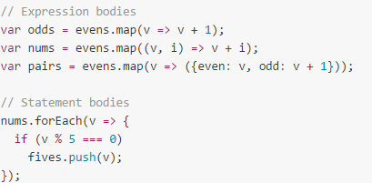
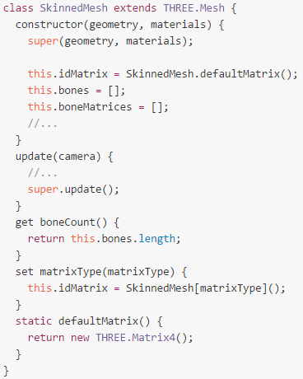
What is new?
Arrows (short hand functions)
Classes

Slide 5
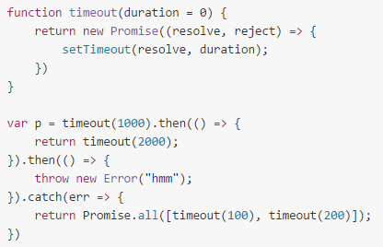
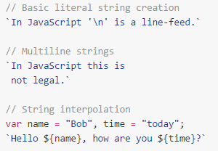
What is new?
Promises
String templates

